Slide 1
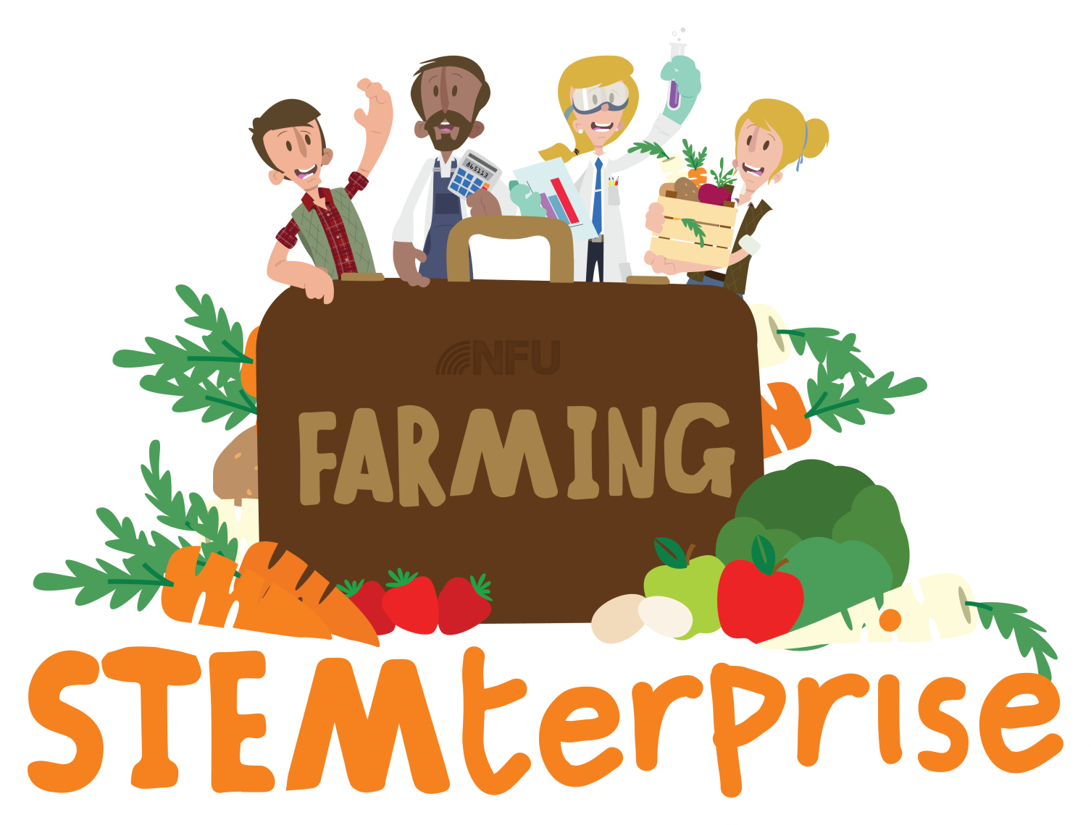
Stage 9: Making a food product

Slide 2
Learning Objective:
To produce a food product
Let’s get ready to cook!
Wash your hands
Tie up long hair

Slide 3
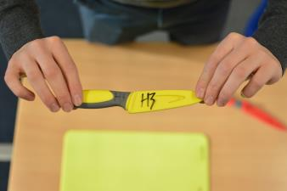
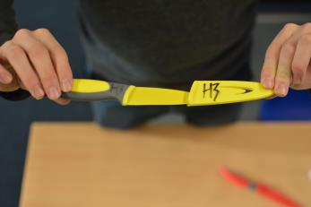
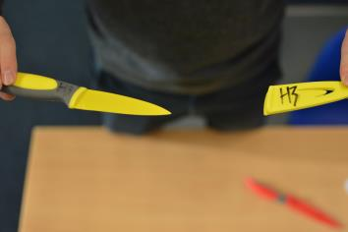
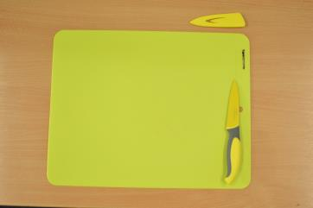
Knife safety
To remove the cover from the knife, pinch the end of the handle and the tip of the knife and face the knife away from you.
Gently, pull the cover away from the knife.
Make sure that you don’t swing your arms and put others in danger.
Your knife is now “active”. Make sure you keep your knife in the safety zone (your chopping board) and if it moves away from your chopping board, you are putting yourself and others in danger.
© Primary Food Tech 2018
Notes:
3

Slide 4
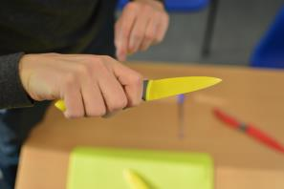
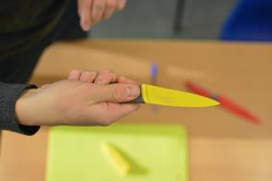
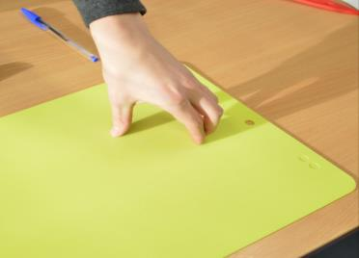
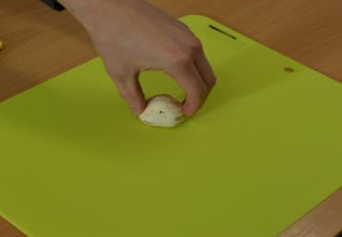
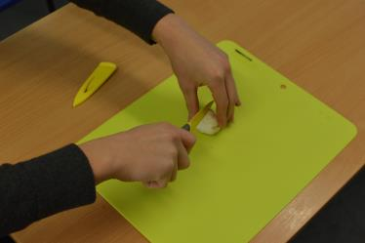
Bridge method
Make sure you have a firm hold on the knife.
Open your hand up. All your fingers need to be together with your thumb on the opposite side.
Grip either side of the food, making sure you have a firm hold.
Put the knife through the middle of your “bridge” to complete the cut.
© Primary Food Tech 2018
Notes:
4

Slide 5
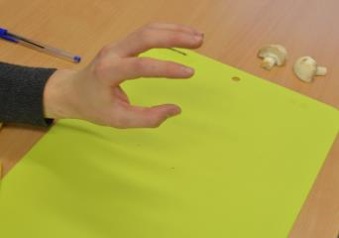
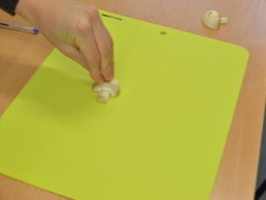
Claw method
Make sure you have a firm hold on the knife.
Hold your hand out and pretend you are “roaring” at someone with your hand.
Make sure your fingers are straight and your thumb is behind your fingers. Hold on tightly with the tips of you fingers.
Slice using the full length of the knife. Remember to keep those fingers straight.
© Primary Food Tech 2018
Notes:
5

Slide 6
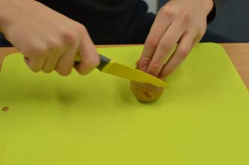
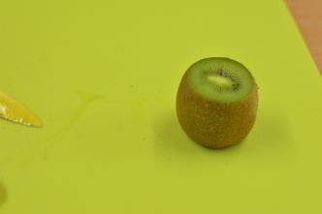
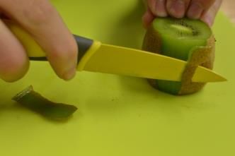
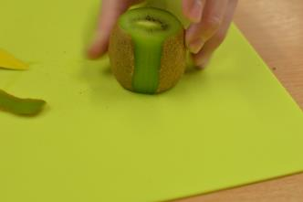
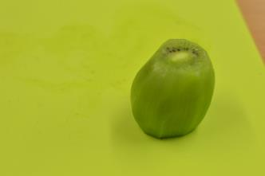
Peeling fruit
Place the fruit on its side and cut off the top and bottom using the claw method.
Place the fruit on a flat surface, so the fruit does not move.
Using the tip and middle of your knife, slice the skin off the fruit in a curved motion.
Once you have removed the first strip of skin, it will be easier to do the rest. Make sure you follow the peel around the fruit.
Here is a kiwi, all peeled ready for the next step. This can be cut up or enjoyed like this.
© Primary Food Tech 2018
Notes:
6

Slide 7
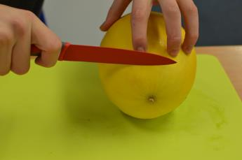
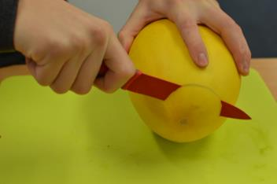
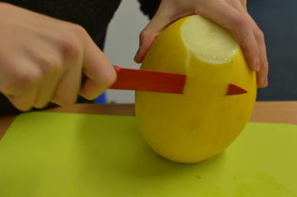
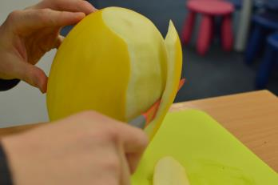
Peeling fruit
Place the fruit on its side and cut off the top and bottom using the claw method.
Be careful because a melon and other fruits like pineapple may slide. Make sure you have a firm grip.
Using the tip and middle of your knife, carefully slice the peel away from the fruit.
Here is a side on view of what it should look like. Try to stay as close to the peel as possible, so you do not waste any fruit.
© Primary Food Tech 2018
Notes:
7

Slide 8
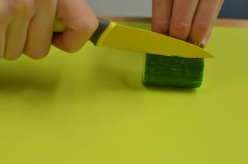
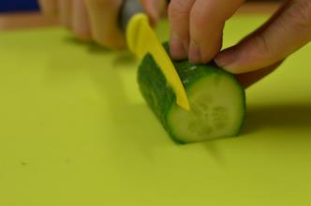
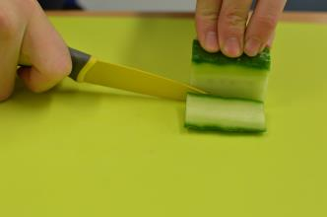
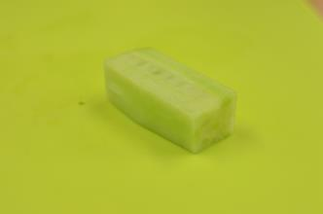
Creating cubes
PART 1
Start with a small chunk of the vegetable. Slice one side off the chunk.
Place the vegetable on the flat side you have just sliced to make sure it is stable to chop your second side.
Keep rotating the vegetable onto the flat sides which have just been sliced until all the sides have been removed.
This is what the vegetable should look like. It should be a cuboid with straight edges.
Notes:
8

Slide 9
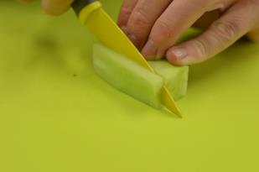
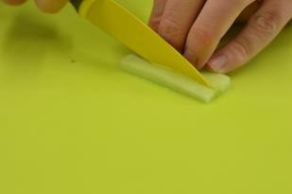
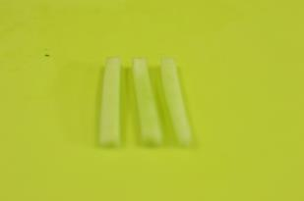
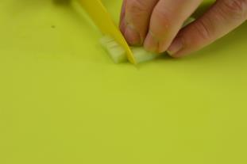
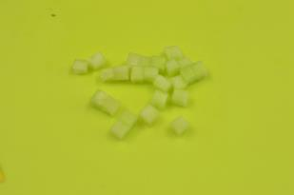
Creating cubes
PART 2
Carefully, using the claw method, cut a chunk of approximately 5mm, depending on the required cube size.
Using the claw method, cut the chunk into strips.
This is what it should look like once you have cut the vegetable into the final strips.
Gather the 3 strips and squeeze them together with your fingers while in the claw method. Cut into the same width as the slices. This will create the cube.
It should end up looking like this. Practise on soft fruits and vegetables like cucumber or beetroot first.
© Primary Food Tech 2018
Notes:
9

Slide 10
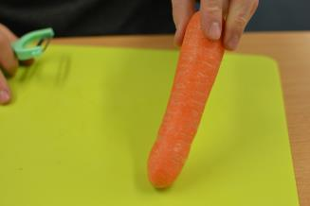
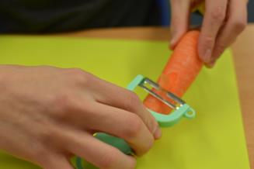
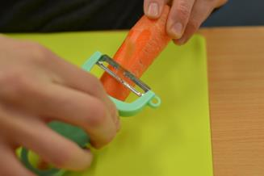
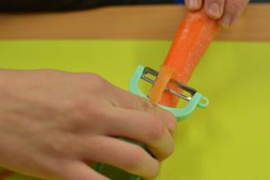
Peeling safely
Hold the vegetable with your fingers gripping at the top. Make sure you have a firm hold and the bottom of the vegetable is firmly on the chopping board.
Make sure you have a firm grip on the peeler and that you start half way down the vegetable.
Don’t press too hard and gently peel the carrot away from your fingers and body.
As you peel, rotate the carrot in your fingers and keep the peeler in the same motion.
If you are peeling a round vegetable like a potato, make sure you have a firmer grip on the potato, but follow the same rule: peel away from yourself.
© Primary Food Tech 2018
Notes:
10

Slide 11
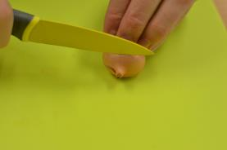
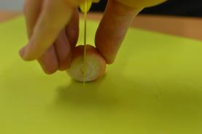
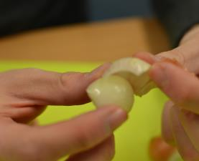
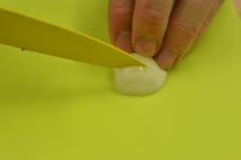
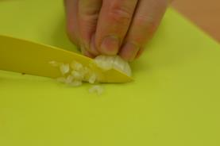
Chopping onions
Using the Claw grip, cut the ‘tail looking’ side off the onion/shallot. Do not cut off the root or the onion will not hold its shape.
Then, using the bridge method, cut the onion in half. Do not
Using your fingers, peel off the outer layer of skin and 1 layer of onion.
Using the tip of your knife, make slices into the onion. Do not cut all the way through. Make sure you are cutting towards the root.
Make sure you have a firm grip on the onion. Turn it to the opposite way you have sliced and cut through it into small pieces.
© Primary Food Tech 2018
Notes:
11

Slide 12
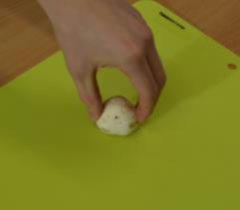
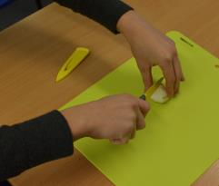
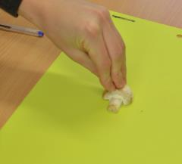
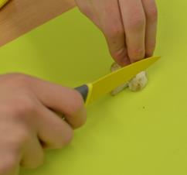
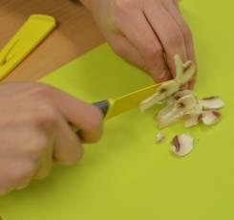
Slicing mushrooms
Hold the mushroom on either side firmly so the mushroom doesn’t move, using the bridge method.
Holding your knife sensibly, slice the mushroom in half making sure the blade is straight.
Get one of the halves of the mushrooms. Make sure you have a firm hold of the mushroom using the claw method.
Sensibly slice the mushroom as thin as you can. Remember to keep your fingers straight.
Remember to use the full length of the knife when cutting. Don’t push down on the mushroom, let the knife do the work.
© Primary Food Tech 2018
Notes:
12

